Slide 1
QUALITY OF SERVICE
Quality of service (QoS) is an internetworking issue that has been discussed more than defined. We can informally define quality of service as something a flow seeks to attain.
Topics discussed in this section:
Flow Characteristics Flow Classes

Slide 2
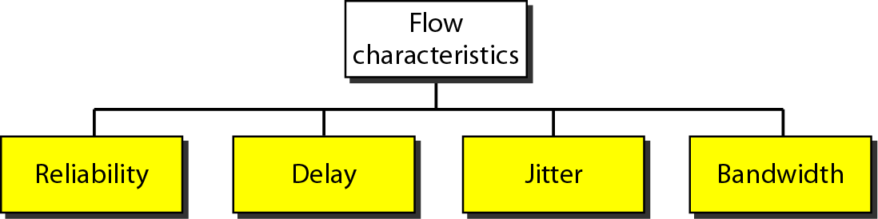
Flow characteristics

Slide 3
TECHNIQUES TO IMPROVE QoS
Earlier we defined QoS in terms of its characteristics. In this section, we discuss some techniques that can be used to improve the quality of service. We briefly discuss four common methods: scheduling, traffic shaping, admission control, and resource reservation.
Topics discussed in this section:
Scheduling Traffic Shaping Resource Reservation
Admission Control

Slide 4
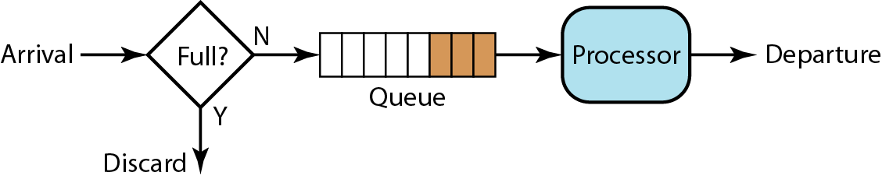
FIFO queue

Slide 5
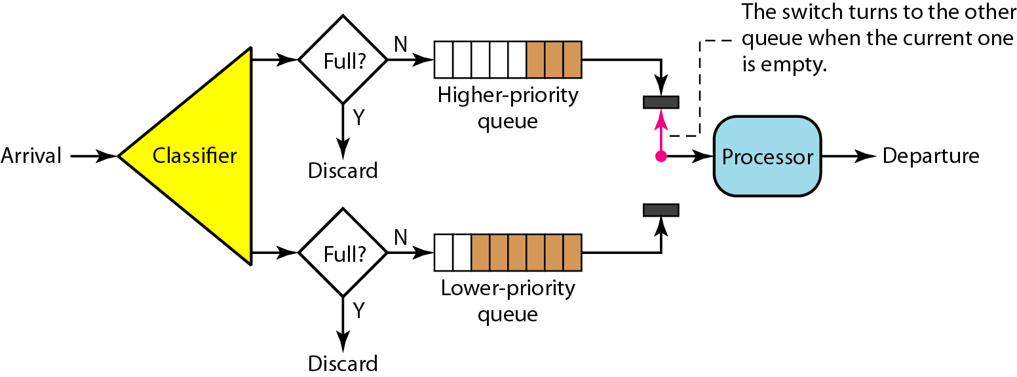
Priority queuing

Slide 6
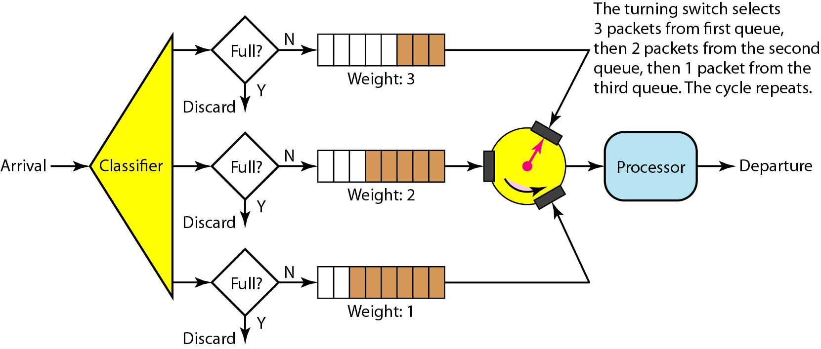
Weighted fair queuing

Slide 7
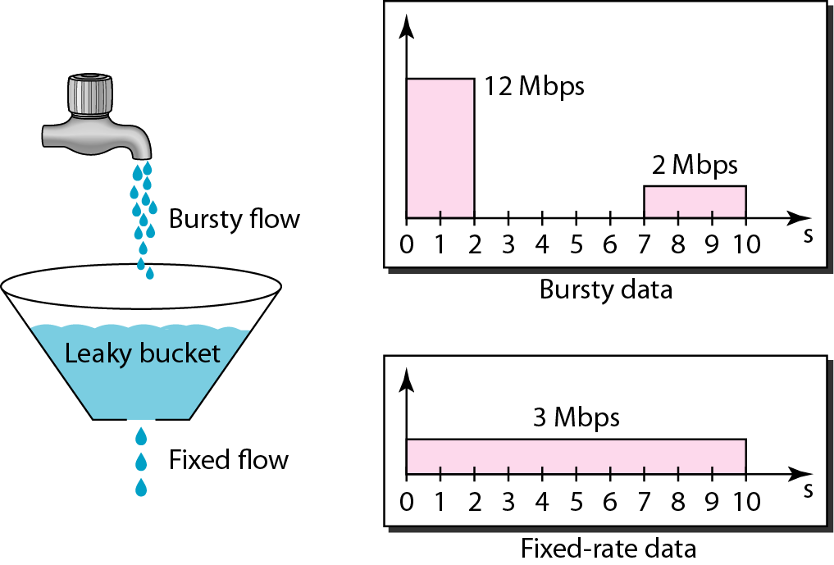
Leaky bucket

Slide 8
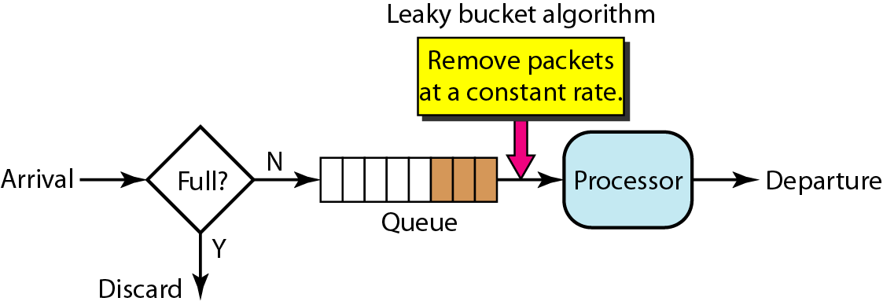
Leaky bucket implementation

Slide 9
A leaky bucket algorithm shapes bursty traffic into fixed-rate traffic by averaging the data rate. It may drop the packets if the bucket is full.

Slide 10
The token bucket allows bursty traffic at a regulated maximum rate.

Slide 11
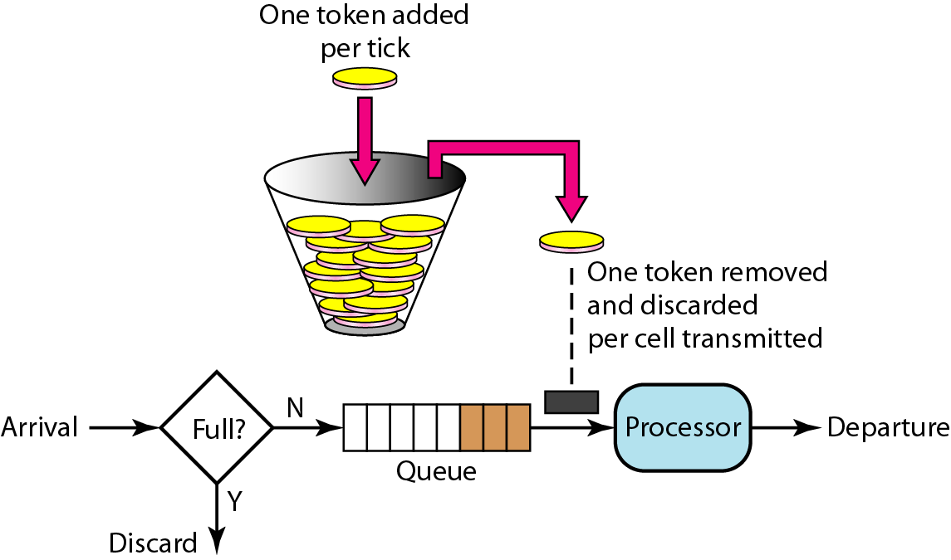
Token bucket

Slide 12
INTEGRATED SERVICES
Two models have been designed to provide quality of service in the Internet: Integrated Services and Differentiated Services. We discuss the first model here.
Topics discussed in this section:
Signaling Flow Specification Admission
Service Classes
RSVP
Problems with Integrated Services

Slide 13
Integrated Services is a flow-based QoS model designed for IP.

Slide 14
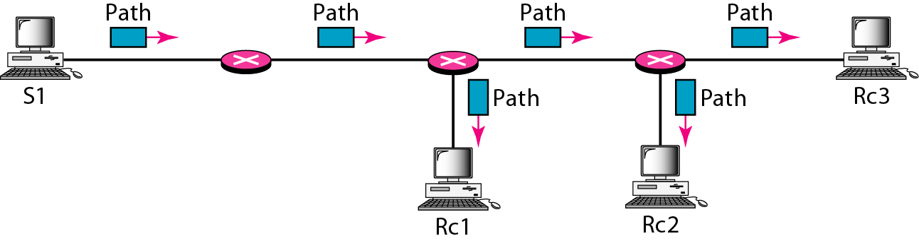
Path messages

Slide 15
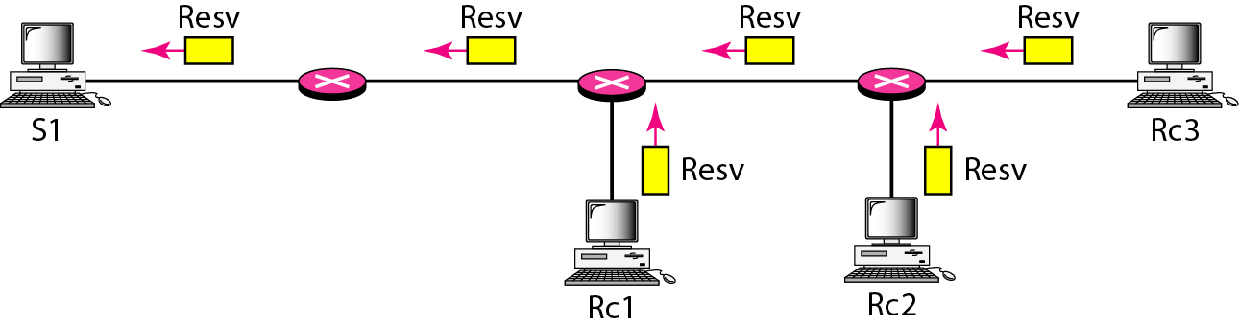
Resv messages

Slide 16
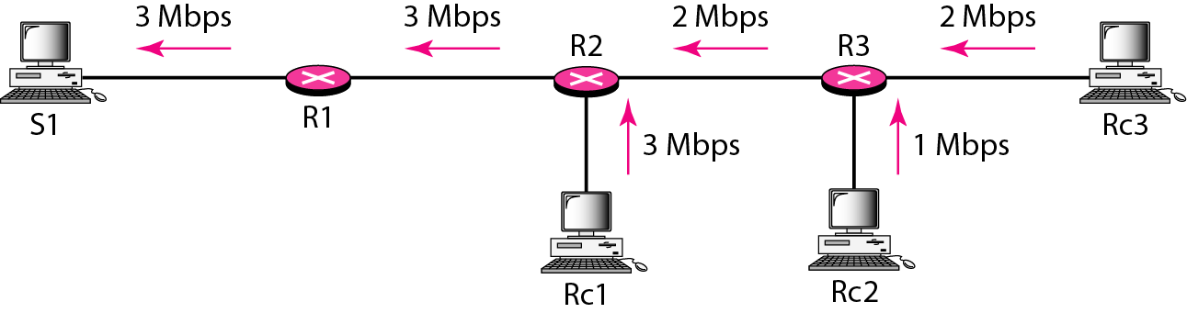
Reservation merging

Slide 17
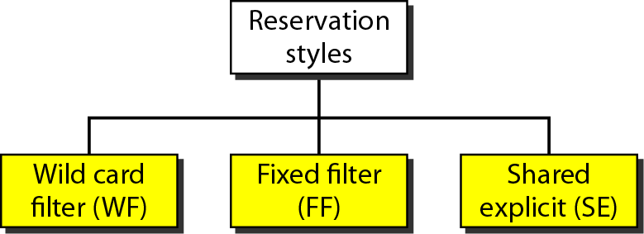
Reservation styles

Slide 18
DIFFERENTIATED SERVICES
Differentiated Services (DS or Diffserv) was introduced by the IETF (Internet Engineering Task Force) to handle the shortcomings of Integrated Services.
Topics discussed in this section:
DS Field

Slide 19
Differentiated Services is a class-based QoS model designed for IP.

Slide 20

DS field

Slide 21
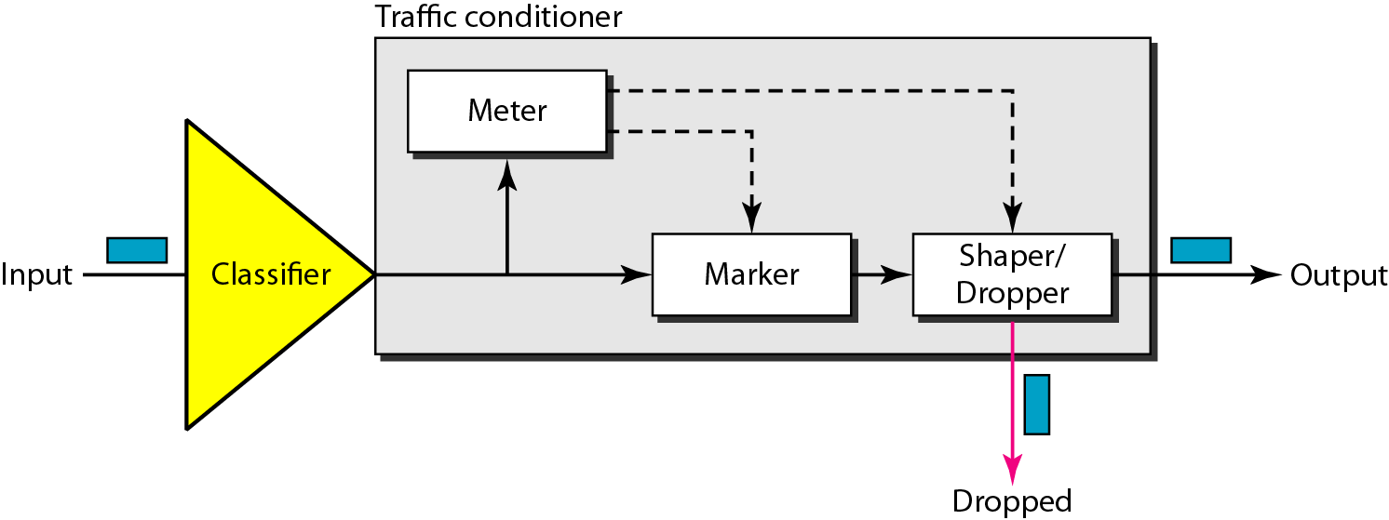
Traffic conditioner

Slide 22
QoS IN SWITCHED NETWORKS
Let us now discuss QoS as used in two switched networks: Frame Relay and ATM. These two networks are virtual-circuit networks that need a signaling protocol such as RSVP.
Topics discussed in this section:
QoS in Frame Relay QoS in ATM

Slide 23
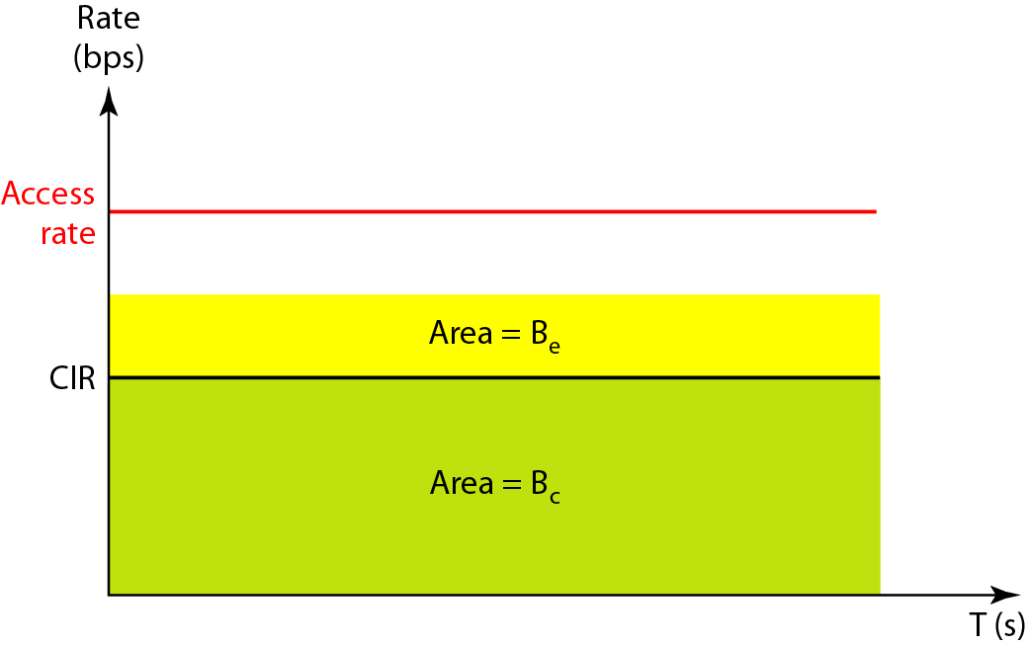
Relationship between traffic control attributes

Slide 24
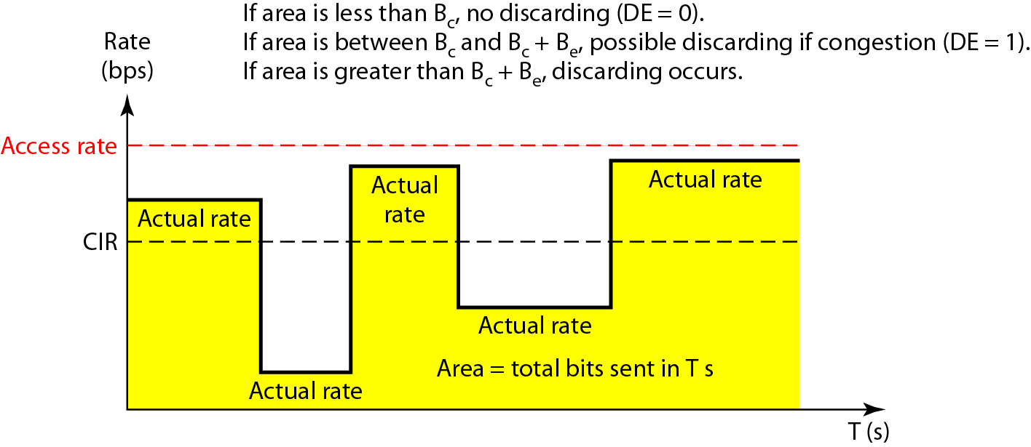
User rate in relation to Bc and Bc + Be

Slide 25
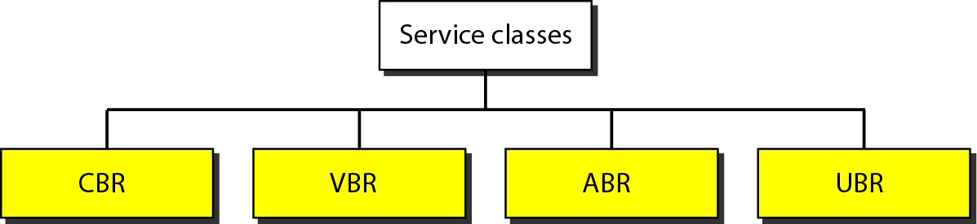
Service classes

Slide 26
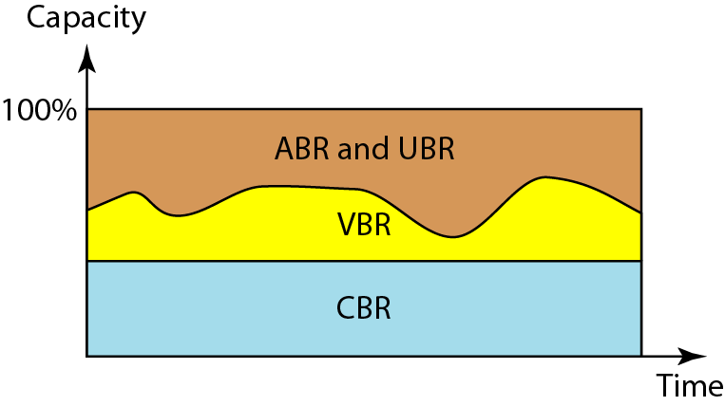
Relationship of service classes to the total capacity of the network

